Slide 1

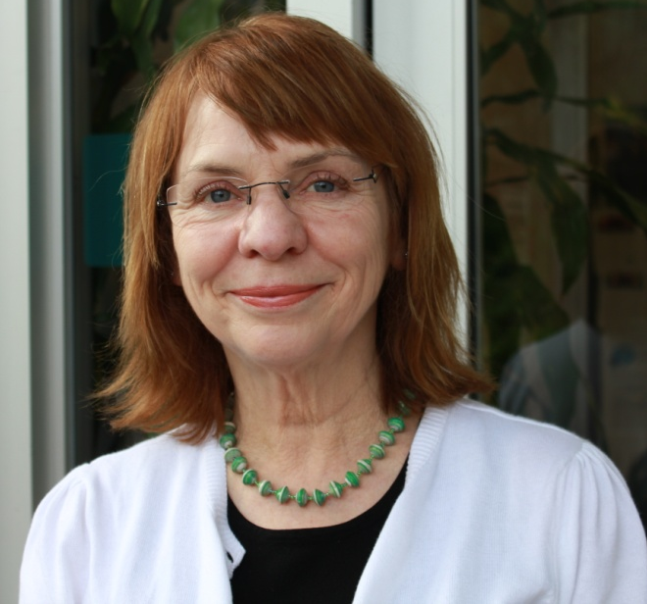
How to Help and then
How to Help the Helpers
Patricia Robinson, PhD
Notes:
Kate introduces Patti & Dr. Gould
Patricia J. Robinson, PhD, has explored integrated care from the perspective of a clinician, researcher, trainer, and health care consultant for over twenty years. Dr. Robinson has worked on behavioral health integration with providers across the country including the HRSA Bureau of Primary Care, the U.S. Air Force and U.S. Navy, Kaiser Permanente, and many city and county health departments. She is an author of numerous articles and book chapters and has published six books, including Real Behavior Change in Primary Care: Improving Patient Outcomes and Increasing Job Satisfaction (New Harbinger, 2010), Behavioral Consultation and Primary Care: A Guide to Integrating Services (with Jeffrey T. Reiter) (Springer, 2007), and Brief Interventions for Radical Change: Principles and Practice of Focused Acceptance and Commitment Therapy (New Harbinger, 2012).

Slide 2
Disclosures (support):
Relevant Financial Relationships:
  Mountainview Consulting Group
  Royalties for books

Slide 3
My journey
The early years – standing side-by-side, PCBH
The middle years – Dr. Gould & Real Behavior Change; the residents
This year – Berlin, Spirited PC in Portland OR

Slide 4
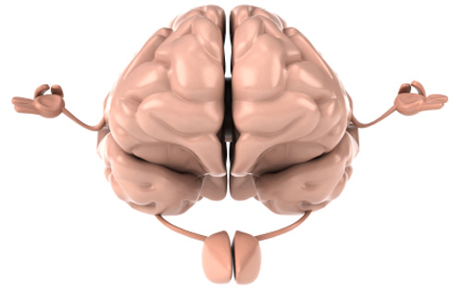
SPIRITED Primary Care
(SPC)
A PCBH Program Pilot
2015
Multnomah County Primary Care Clinics

Slide 5
Spirited PC
Three 2-hour classes
All volunteering participants
Before class 1:
PCP Acceptance and Action Questionnaire
PCP Stress Checklist
Notes:
Deb - Jennifer Gregg – CHC; Jonathan Bricker – Seattle, telephone and web-based. Anyone interested in being involved in research in ACT in your clinic let us know.
2 minutes

Slide 6

Showing Up
Mountain, Wind, Sky
Breath
Sensation
Thought
Emotion
Why is this work important?
  What, at the end of the day, do you hope for?

Slide 7
Overview
Burnout – What is it? What predicts it? How does it affect me and my medical practice?
Evidence for ACT as intervention – How can Acceptance and Commitment Therapy (ACT) help build psychological flexibility and help us deal with burnout?
ACT concepts and practices

Slide 8
Burnout Rates
Medical Students – 45%
Residents – 27% FP to 75% OB-GYN
Attendings – 20% - 65%
Limitations of studies – poor response rates, definition of burn-out (EE, DP, PA).

Slide 9
ACT
Relational Frame Theory (Learning, Language, Rules of Behavior)
Contextual Functionalism
(Context, Workability)
Behavior Analysis (ABCs)
The Science of ACT
Notes:
Patti - Strong Theoretical basis – 20 years of research in mental, behavioral health, physical rehab and more recently in medical settings. ACT is the technology that comes from Relational Frame Theory and Contextual Functionalist philosophy, grounded in a school of psychology of Behavior Analysis.
2 minutes

Slide 10

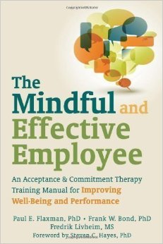
ACT Evidence
NIMH website of Evidence-Based Treatments
Specialty, Community Settings
Tobacco cessation – phone counseling
Obesity
Depression & Anxiety
Chronic Pain
Workplace
Primary Care
DMII - Gregg et al., 2007
  RCT – 4 hour workshop
  ACT ACT plus Education vs Education alone
  Outcomes – 3 months post class
  Reported better diabetes self-care
  HbA1c in target range.
(Improving Diabetes Self-Management Through Acceptance, Mindfulness, and Values: A Randomized Controlled Trial, Journal of Consulting and Clinical Psychology, 2007, Vol. 75, No. 2, 336–343)
Notes:
Deb - Jennifer Gregg – CHC; Jonathan Bricker – Seattle, telephone and web-based. Anyone interested in being involved in research in ACT in your clinic let us know.
2 minutes

Slide 11
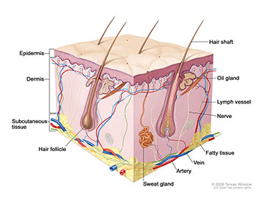
The Human Situation
Public Behavior
Private Behavior
What can be seen
Examples
Inside the skin
Cannot be directly observed
Can be imaged

Slide 12
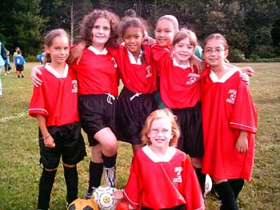
TEAMS (Private Experience)
Emotions
Associations
Memories
Thoughts
Sensations

Slide 13


Experiential Avoidance
Avoid uncomfortable thoughts & feelings………
Notes:
Patti - Feeling bad is normal…..we have to counteract a whole culture that encourages people to avoid dealing with uncomfortable thoughts and feelings.
Are we willing to experience uncomfortable thoughts and feelings in the service of pursuing what is important to us/our values?
2 minutes

Slide 14
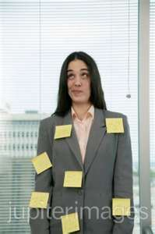
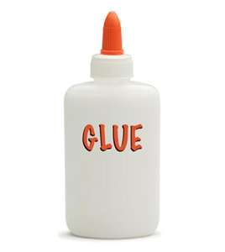
Cognitive Fusion
Entanglement in our thoughts
dominate our awareness
have a huge influence over our behavior.
“Being pushed around by TEAMS”
“Sticky Thoughts”

Slide 15
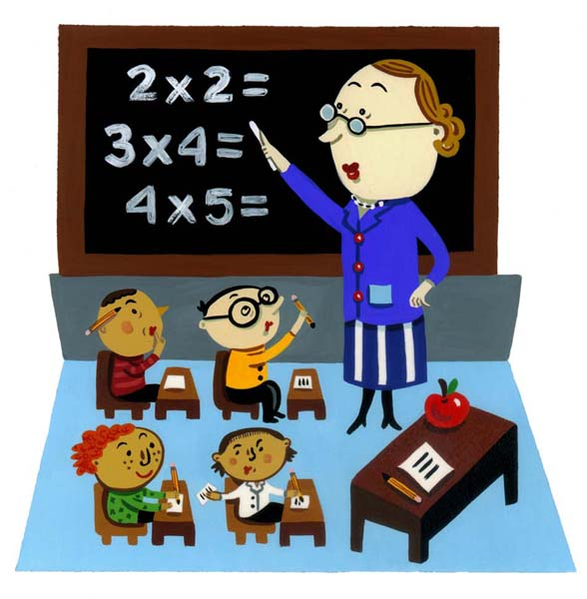
Learning Histories
(Relational Frame Theory)
Rules that applied in the past may not apply now! Nested in language that frequently operate outside our awareness. They are socially transmitted and can’t be unlearned!

Slide 16

Workability & Willingness
“Has what you’ve been doing helped you get to where you want to be according to your values? (short term vs. long term effects)”
“Are you willing to try something different?”
Notes:
Are you willing to try something new?

Slide 17
Resiliency - Core Processes
Be Present
Acceptance
Connect with
Values
Psychological
flexibility
Defuse
Act on Values
Changing Self
Notes:
Explicit connection between how ACT processes overlap in dealing with burn-out factors – e.g. EE – Avoidance, EE – Avoidance, Fusion; DP-Not present, Rigid perspective; PA – Disconnected with Values and inaction or not acting according to Values.

Slide 18
Bulls-Eye Worksheet

Slide 19

Bulls Eye Professional Plan Follow-up
Action Steps

Slide 20
Passengers on the Bus
Exercise

Slide 21

SPRITIED PRIMARY CARE Experiment
POST IT
  Post Personal Action Plan (frig door or office area)
OPEN UP
  Three minute Openness Practice at beginning of workday
NOTICE
  Value consistent behavior detection at end of day
PRACTICE
  Follow through on your SPIRITED PC Skill Practice Plan

Slide 22
SPIRITED Primary Care
(SPC)
Class 2

Slide 23
SITTING UPRIGHT—A SIMPLE BEHAVIORAL STRATEGY TO HELP BUILD RESILIENCE TO STRESS
Do slumped and upright postures affect stress response?
Randomized control trial, 74 participants, told a cover story to reduce expectation effects, completed two stressful tasks, blood pressure and heart rate continuously measured (tape strapped to back)
Upright participants: reported higher self esteem, more arousal, better mood, and lower fear
Slumped participants: used more negative emotion words, first person singular pronouns, affective process words, sadness words, fewer total words (during the speech stressor). Used linguistic analysis
  Nair, et al. 2015. Health Psychology, The University of Aucklund, 34(6), 632-641

Slide 24
Overview
Review of clinician resiliency model
Review of SPIRITED practice plan
Identify facilitators and barriers to change
Use “choice point” exercise
Overview of Matrix Flexibility Tool
Bulls-Eye SPIRITED practice plan

Slide 25
Think about something you’ve wanted to do at work because it is important to you
Then list out 3 or 4 things that deter you or move you away from doing it

Slide 26
CHOICE POINT
AWAY
“Unworkable”
TOWARDS
“Workable”
MINDFULNESS SKILLS
DIFFICULT, UNHELPFUL
THOUGHTS & FEELINGS
VALUES
SKILLS &
STRENGTHS
CHALLENGING MOMENT
At the choice point, STOP:
S- Slow down - Slowly breath; or slowly press your feet down; or slowly stretch
T-Take note - Notice what you are feeling & thinking; notice the world around you & what you are doing
O-Open up - Make space for your thoughts & feelings; allow them to freely flow through you
P -Pursue values - Remember your values, and find a way to act on them (no matter how small) Ciarrochi, Bailey, and Harris, 2013

Slide 27
Choice Point Exercise
Discuss choice point related to valued action with partner
Think through how you could make a “toward values” move

Slide 28
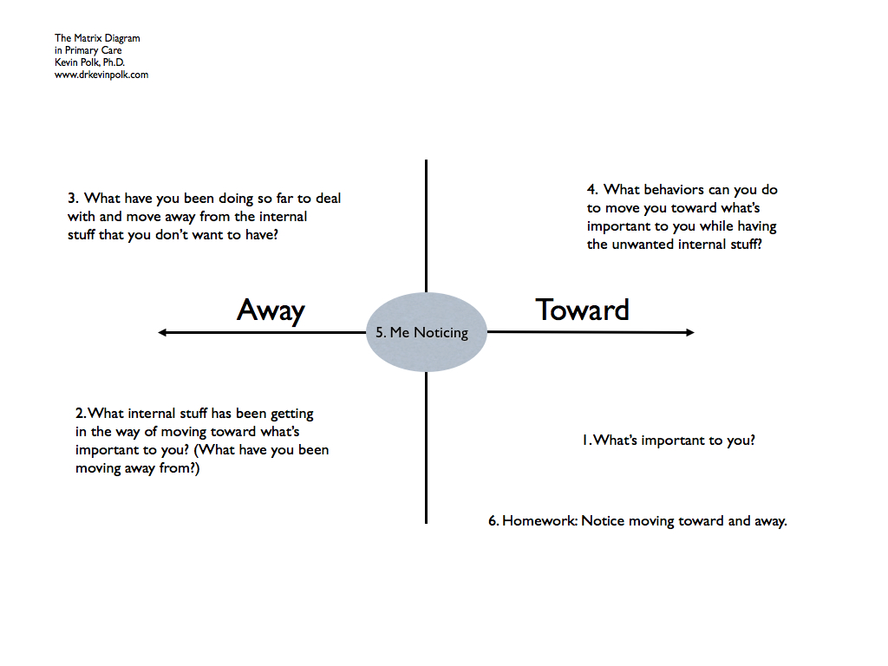

Slide 29
SPIRITED Primary Care
(SPC)
Class 3

Slide 30
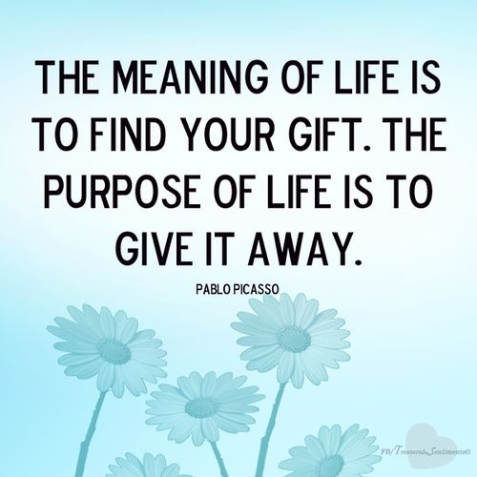
Notes:
Talk with your partner: What is your gift? Who gave it to you? Who do you give it to?

Slide 31
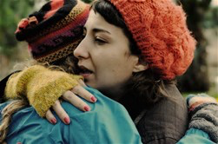
Compassion
Mountain, Wind, Sky
Loving someone
Loving myself
Loving
Notes:
Spirit:

Slide 32
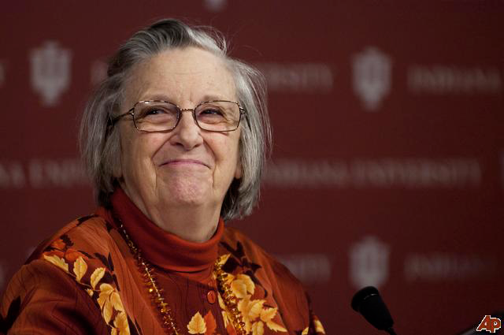
Elinor Ostrom
2009 Nobel Prize in Economics

Slide 33
Elinor Ostrom’s 8 Steps:
How to Make Groups Work (for the Greater Good)
1. Strong group identify and purpose
2. Proportional equivalence of costs and benefits
3. Consensus decision-making
4. Monitoring
5. Graduated sanctions (start mild and friendly; use many more positives than negatives, but be able to step it up)
6. Fast, fair conflict resolution
7. Local autonomy (elbow room)
8. Polycentric governance among groups
Notes:
Implement these principles and the impact on children – even children growing up in challenging environments – is immediate (days and weeks not months); See study on putting small groups of middle schoolers in charge / / / is with slides about the camilion: Principle: If you want to change the way a camillion looks, do you change it’s background or do something else?
Multilevel Selection and the Invisible Hand
If you only care for family and not for tribe, a problem
If you only care for tribe and not for family, a problem
Good parent duck in a new environment – not “bad parenting” just not prepared for the new environment
Evolution only prepares folks for past environments not future
Duck with babies crossing a grate
Examples of evolutionary mismatch: diet ,exercise, immune system dysfunction, our built environment, our society mechanism of social learning, and culture transmission (result is practices that work but don’t spread)
Polycentric: having many centers, especially of power or importance:

Slide 34
Effective monitoring by monitors who are part of or accountable to the appropriators;
The self-determination of the community is recognized by higher-level authorities;
Collective-choice arrangements allow most resource appropriators to participate in the decision-making process;
Organizational Flexibility Meets Elinor Ostrom
Good Monitoring / Flexible Attending
Clear Values and Goals / Chosen by Group
Active Steps Linked to Values and Goals
Aware of Perspective/ Context and that of Others
Multiple Views, Filtered by Workability
Openness to Distress, Problems, Conflict
Mechanisms of conflict resolution are cheap and to easy access;
Rules regarding the appropriation and provision of common resources are adapted to local conditions;
There is a scale of graduated sanctions for resource appropriators who violate community rules;
In the case of larger common-pool resources: organization in the form of multiple layers of nested enterprises, with smaller groups at the base level.

Slide 35
Group Design Exercise
Use worksheet
Work in groups of 3 (all from different clinics if possible)

Slide 36

FIVE STEPS TO TRANSCEND STRESS
USING MINDFULNESS AND NEUROSCIENCE*
OBSERVE
DESCRIBE
DETACH
LOVE YOURSELF
ACT MINDFULLY
BRAIN TRAINING EXERCISES
INTEGRATE
  SELF CARE ROUTINE
  FAMILY LIFE
  WORK LIFE
*Strosahl, K. & Robinson, P. (2014). In This Moment: Five Steps
to Transcending Stress Using Mindfulness and Neuroscience.

Slide 37
FIVE FACET MINDFULNESS QUESTIONNAIRE
Self-Compassion Questionnaire – Short Form
Choose a way to track your progress . . .

Slide 38
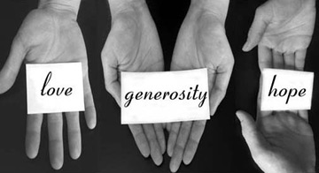
And practice makes permanent

Slide 39

Until we meet again, may you practice a little alien breathing

Slide 40
Results
High impact for some, particularly younger PCPs
  Med Dir: “She’s completely different – sees her patients in a timely manner; she’s happy; patients are happy; she goes home on time”
Positive response to PCPs sharing new skills with team
Inclusion of BHCs useful, but not endorsed overall
Concerns about how to maintain new skills after end of class series

Slide 41


And will you teach it forward to the team?
Tree of Service
  Roots / value that brought you here
  Branches / leaves – practices
  Trunk – Your team
Medicine: Give help … and ask for help
Request(s) everyday all day
Promise: Respond mindfully to sign with
  4 shared breathes
Sign
  Now
  Friend
  Help

Slide 42
Where’s the Magic?
Content
Process
ACT for sure
Include evidence
Adapted to medicine culture (metaphors, pictures)
Link to assessment (PCP Stress Checklist, PCP AAQ)
Respectful of PCP leadership role
1st intervention when?
Available at time of need
Not mandated
Minimizes stigma
Venue context (clinic basement vs. community park)
Minimal dose
Amount and nature of on-going support

Slide 43

Need credit for this session?
Please don’t forget to
scan out.
What did you think?....
complete the 3 question quickeval
for this session at
https://contextualscience.org/quickeval
This was presentation was session # 45

